Slide 1
ROSATOM
Rosatom State nuclear corporation
AKKUYU NGS AŞ
Akkuyu NPP construction.
Akkuyu requirements for contracts’ personnel
Atomexpo -2013
Biezbardis V.Ya.
Notes:
1

Slide 2
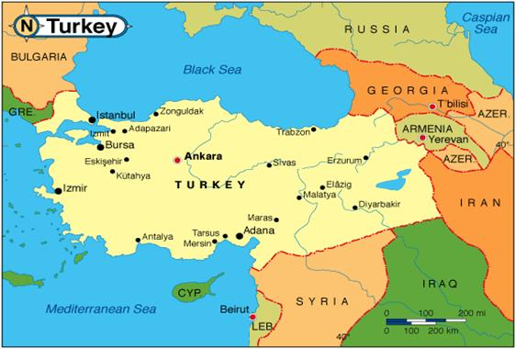
Akkuyu Nuclear Power Plant is the First Rosatom BOO Construction Project Outside Russia
ROSATOM
AKKUYU NGS AŞ
Akkuyu Project Features
First Nuclear Power Plant in Turkey
First Rosatom ВОО (build-own-operate) project. Under the IGA, Rosatom is responsible for engineering, construction, operation and maintenance of the plant.
Legal basis: Intergovernmental Agreement, May 12, 2010
Project design: AES-2006 (VVER-1200)
Total capacity: 4,800 MW. (4 x 1200 MW)
Implementation period: 2011-2023
Total cost ~ $ 20 bln.
Power Purchase Agreement for 15 years, fixed price terms
Support of the Russian and Turkish Governments
Akkuyu site, Turkey
Notes:
Помимо занятых в строительстве (только на строительной площадке в «пиковые годы» будет работать до 10 000 человек одновременно), на АЭС будут задействованы более 2500 человек эксплуатационного персонала, а во время плановых ремонтов будут привлекаться еще около 1200 человек.

Slide 3
Major Milestones of the Project
ROSATOM
AKKUYU NGS AŞ
Commissioning
1 stage
2 stage
3 stage
4 stage
Construction
Operation and
maintenance
Decommissioning
Preparation
13.12.2010
03/2011
2015
2016
01/2016
2020
2080
1 блок
1 unit
2021
2 unit
2 блок
2022
Akkuyu JSC registration
2 unit
Electricity generation license
3 блок
2023
3 unit
Start site survey
4 блок
First concrete
4 unit
NPP construction license

Slide 4
Project organization structure
ROSATOM
AKKUYU NGS AŞ
Rosatom State Corporation
Board of Directors
(shareholders)
Project sponsor
PC management
General responsibility for Project implementation
Rusatom Overseas CJSC
Investor/ developer
Akkuyu NPP JSC
Tailor-made JSC incorporated in Turkey. Carries functions of customer, license applicant, NPP owner and GR coordinator in Turkey
Owner of the NPP and electricity produced
Owner’s Engineer
OJSC «INTERRAO
Worley Parsons»
Atomstroyexport – NIAEP
Rosenergoatom Concern OJSC
Technical expertise
Cost control
Schedule control
Quality control
Prime contractor
Technical customer
Licensing consultant
Engineering surveys
Construction and assembly works
Equipment and materials supply
Development of pre-design, design and detailed design documentation
Technical acceptance of equipment and services at all stages of project commissioning, NPP operation
Atomenergoproject OJSC
Principal Designer
Gidropress Design Bureau
Nuclear Island principal designer
Kurchatov institute
Scientific advisor
VNIIAES JSC
System integrator
Automatic process control system principal designer
Alstom-Atomenergomash OJSC
Turbine-generator designer, including turbine building auxiliary equipment
VNIPIET OJSC
Designer of construction and assembly technologies
* Tender will be held in 2013
4
Notes:
4

Slide 5
Requirements for
the prime contractor and technical customer
ROSATOM
AKKUYU NGS AŞ
Requirements for the Prime Contractor
Requirements for the Technical Customer
Experience in NPP construction, including “turn-key” contracts
Financial solvency (an opportunity to provide financial securities, providing funding for the construction etc.)
Availability of qualified personnel with experience of NPP construction (project management, construction management, complete equipment with components etc.)
Availability of quality management system and registration with the regulatory body
Experience in NPP-related work management, including: design, technical support, technical acceptance of construction and assembly work and equipment, pre-commissioning and commissioning with providing certificate of plant availability
Solvency of the Technical Customer (provision of bank guarantees, work funding)
Skilled staff available with past performance in the nuclear industry in the above listed disciplines
The Quality Management System available and registration in the regulatory agency
5

Slide 6
Licensing stages participants interaction chart
ROSATOM
AKKUYU NGS AŞ
Ministry of Environment and Urban Planning
Technical customer (Rosenergoatom)
EIA,
All the permits for work completion, including coast zone construction
Design works
Commissioning
Operation
Akkuyu NPP JSC
Ministry of Energy and Natural Resources (MENR)
IGA executive body
Licensing consultant (WP)
ТАЕК
Licenses:
site
construction
commissioning
operation
Developing EIA
Design documents expertise
Providing INIR materials
Developing post-Fukushima stress tests report
Turkish Report to IAEA and other consulting services
EMRA
Generation license
Other ministries, agencies, legal entities
Concurrence of permits issued by the Ministry of Environment and Urbanization
Marine Affairs Secretariat of the Cabinet of Ministers
Opinion on possibility to modify the coast line
6

Slide 7
Equipment and services estimated cost breakdown
ROSATOM
AKKUYU NGS AŞ
Opportunities for localization during Akkuyu NPP construction (share of the total cost)
 | $ bln
Construction (Turkey and other states) | 4,8
Construction (Russia) | 0,3
Equipment (Russia) | 5,6
Equipment (Turkey and other states) | 1,4
Assembly Work (Turkey and other states) | 1,6
Assembly work (Russia) | 2,3
Design and Engineering | 0,9
Project management | 1,2
Misc | 1,2
Equipment (Russia)

Slide 8
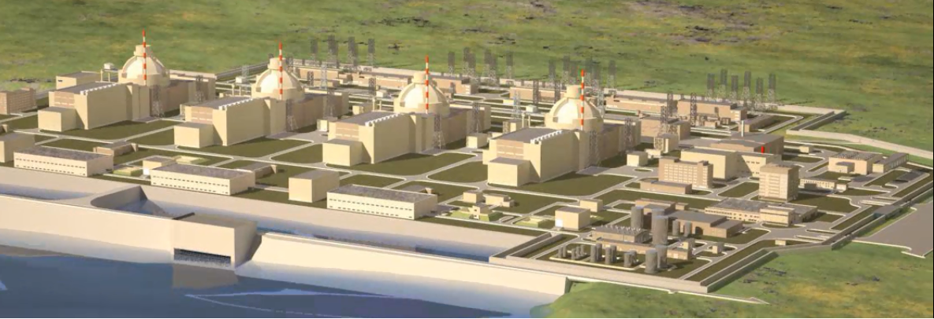
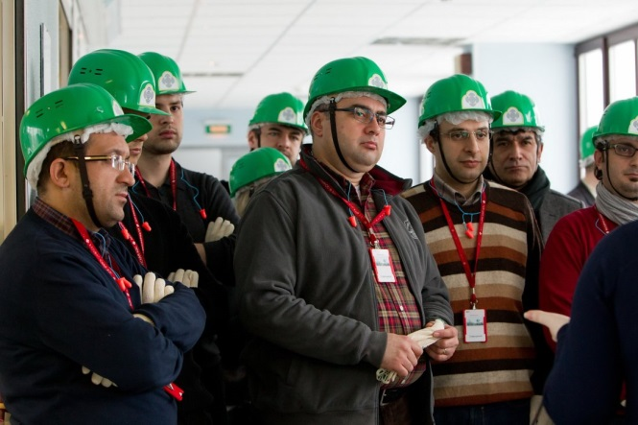
Requirements for Russian contractors during licensing (preparatory stage) and CAW execution
ROSATOM
AKKUYU NGS AŞ
Availability of relevant licenses and other credentials in the nuclear energy
Availability of SRO certificate authorizing the work affecting the safety of nuclear energy facilities, dangerous special, technically complicated and other capital construction facilities when performing construction, re-construction and overhaul
Availability of a system to certify and professionally develop company’s employees
Availability of the compliance certificate with the applicable quality management system
Availability of the fixed assets required to fulfill relevant work
Availability of adequately qualified personnel
Availability of engineering staff knowledgeable about the Rules and Norms of the nuclear energy
8

Slide 9
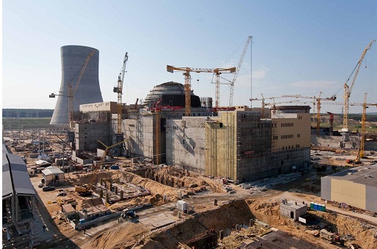
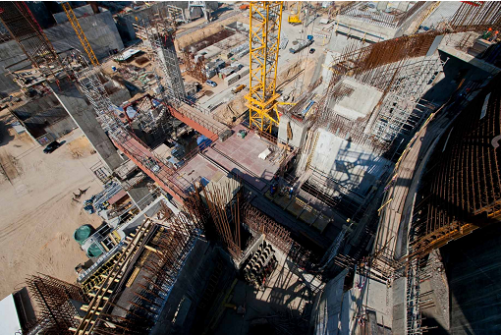
Requirements for Turkish contractors during licensing (preparatory stage)
ROSATOM
AKKUYU NGS AŞ
Requirements for Turkish contractors
Requirement for personnel of Turkish contractors
1. Licenses and certificates available for certain kind of activities (accreditation) of companies in the supervisory and regulatory agencies of Turkey
2. Requirements for quality and results of work/services are to be determined by:
Regulatory documents of the licensing base
Quality regulations per types of performed activities
Quality plans
3. Reference available – experience in similar work performance
1. Qualification and competence available to perform the required work
2. The engineering staff should be registered (membership) in the relevant engineering chambers of Turkey
9

Slide 10
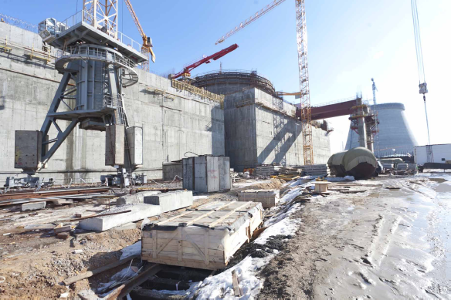
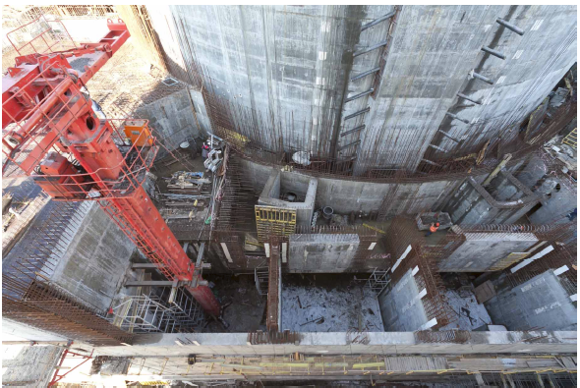
Requirements for Turkish contractors during
construction
ROSATOM
AKKUYU NGS AŞ
Requirements for Turkish contractors
Requirement for personnel of Turkish contractors
Availability of reference – experience in executing the work, being the subject matter of the contract
Availability of own machines and equipment, needed for work performance («sub-contract»)
Capacity to accomplish the work, being the subject matter of the contract, by its own forces (minimum attraction of sub-contractors)
1. Qualification and competence available to perform the required work
2. Special permits available to perform dangerous special work
10

Slide 11
Algorithm for selecting a suppler of equipment, materials and services
ROSATOM
AKKUYU NGS AŞ
Development of project requirements
Turkish market research (audits of supply companies of equipment, materials and services)
Getting information about products, services, including the regulatory base, which is the ground for manufacturing and testing materials and equipment; technical characteristics of materials, equipment
Comparative analysis of compliance of the equipment and materials characteristics with the project requirements
Preparation of equipment and materials range, list of work/services
Listing of manufacturers, suppliers of work/services
Elaboration of requirement for companies (personnel, equipment, including for tests, QMS, licenses, certificates)
Auditing companies, including forwarding requests, audits directly at manufacturer’s sites
do not comply
comply
Delivery
Contract
Invite and hold a tender
Inclusion potential suppliers’ data into the database

Slide 12
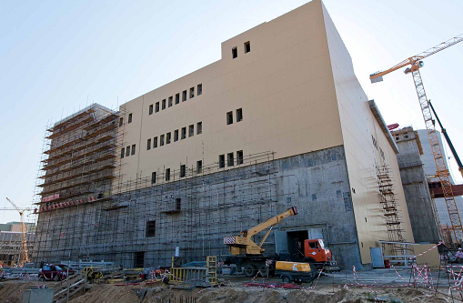
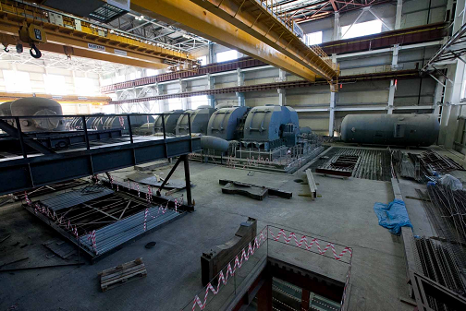
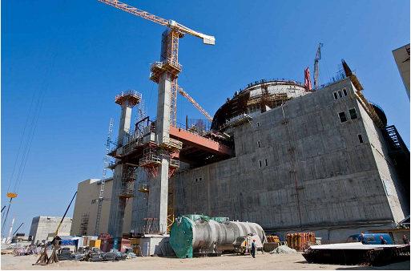
Example. Requirements for participants of the competitive negotiations to develop the Design and Detailed Documentation per facilities (partial)
ROSATOM
AKKUYU NGS AŞ
Have necessary licenses or certificates allowing goods delivery, work performance of service rendering, valid for the time of opening the envelopes with tender offers under the applicable law of the Republic of Turkey and if such goods, work, services are to be acquired under the contract to be signed;
Have all relevant authorizations to perform the activities related to contract implementation, the right to sign which is the subject of the present competitive negotiations to the extent of the work to be accomplished under the work breakdown structure, including:
authorizations under the law of the Republic of Turkey to perform design work;
authorizations under the law of the Republic of Turkey to conduct engineering surveys;
Have a system of methodological support, namely:
accounting management of measuring devices and control of testing equipment;
certified techniques to perform measurements, tests and control;
Inspection certificates, certificates of calibration and/or calibration stamps for measuring and control devices, certificates for testing equipment.
Have applicable quality management system (quality management, assurance and control), meeting the requirements of the International Standard ISO 9001:2008 (or its national equivalent);
Have regulatory and technical documentation defining the requirements for work performance and quality control.
12

Slide 13
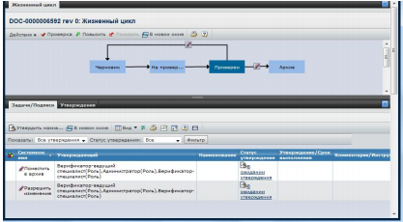
Participation of Turkish companies in Akkuyu NPP construction
ROSATOM
AKKUYU NGS AŞ
AKKUYU NPP JSC, Atomstroyexport CJSC have accomplished the following when evaluating capabilities of the local industry to supply equipment and materials and render services:
Procedure for preliminary evaluation of potential manufacturers of construction materials, equipment and service providers during Akkuyu NPP construction has been developed;
Requirements and criteria for evaluation of manufacturers of construction materials and equipment have been developed;
On AKKUYU NPP JSC’s instruction, specialists of ASE CJSC conducted 38 marketing inspections of large construction and assembly companies and 176 marketing inspections of manufacturers of construction materials and equipment to determine technical potential of the Turkish industry as well as to find out prices of the main construction materials, equipment and services; the database has been created;
Under guidance of the Turkish Ministry of Energy and Natural Resources (MENR) the working group on localization of equipment fabrication for Akkuyu NPP in the Republic of Turkey has been established, which includes representatives of AKKUYU NPP JSC, Atomstroyexport CJSC, PKF of Rosenergoatom Concern;
The teams of Turkish specialists are to be trained the way how to apply EONKOM (Unified Nuclear Industry Catalogue of Equipment & Materials) in the city of Nizhni Novgorod in summer 2013.
- Training workshop for representatives of companies of the Republic of Turkey.
- training workshop for representatives of the Industrial Chambers and Agencies of Entrepreneurship Support of the Republic of Turkey.
Training for Turkish companies how to apply the EONKOM catalogue in Ankara.
13

Slide 14
Thank you for attention! www.akkunpp.com 27 Farabi Street, Chankaya, Ankara, 06550, Turkey +90 312 442 60 00 2, Paveletskaya sq., bldg. 2, 115054 Moscow, Russia +7 495 258 99 00 office@akkunpp.com
ROSATOM
AKKUYU NGS AŞ

