Slide 1
IAEA’s Project INPRO – a platform for strategic cooperation in Nuclear Fuel Cycle
Presented by Vladimir KUZNETSOV
On the Behalf of the INPRO Group
Atomexpo 2013
S. Peterburg, 27 June 2013

Slide 2
Establishment of International Project on Innovative Nuclear Reactors and Fuel Cycles (INPRO)
Origins:
Initiated in 2000, authorized by IAEA General Conference resolutions
Membership based , funded mainly from extra-budgetary contributions
Objectives:
To cooperates with Member States to ensure that sustainable nuclear energy is available to help meet the energy needs of the 21st century.
To bring together technology holders and users so that they can consider jointly the international and national actions required for achieving desired innovations in nuclear reactors and fuel cycles
INPRO is part of the integrated services of the IAEA provided to Member States considering initial development or expansion of nuclear energy programmes.

Slide 3
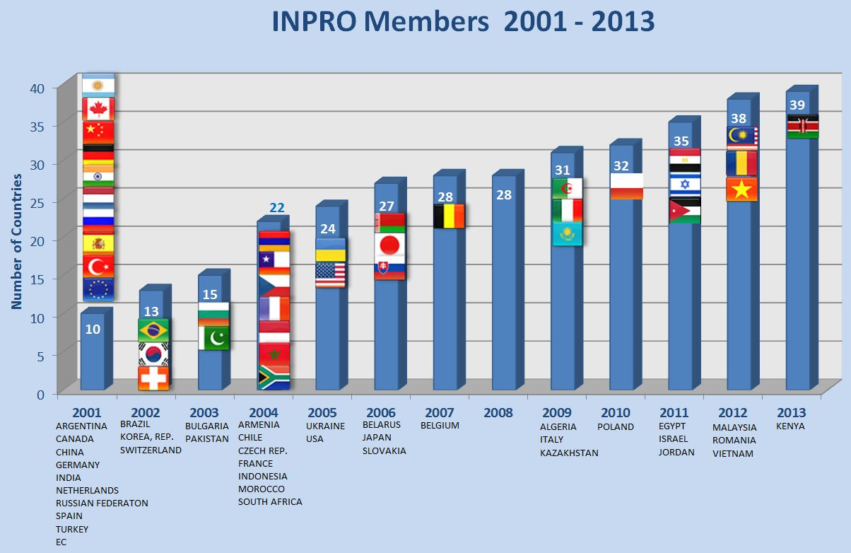
INPRO Membership 2001-2013
Look how many countries have jointed the INPRO. Among these countries are those that hold technologies and those that are willing to use these technologies. But all of us are working in harmony to achieve better results and to jointly satisfy the future needs of the mankind.

Slide 4
INTEGRATION OF INPRO PROJECTS

Slide 5
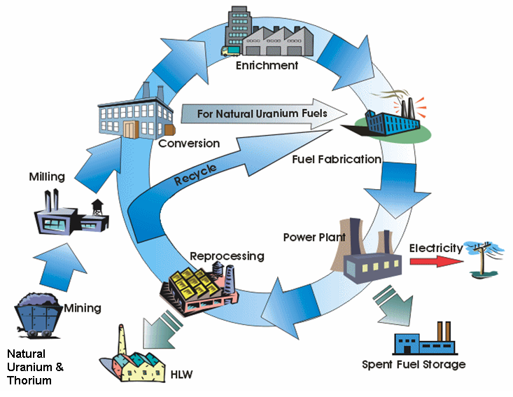
Holistic nature of INPRO Methodology
NES includes all components
What INPRO is offering to people – a holistic working level mechanism for paving stability on national and regional levels and globally.
Notes:
Holistic in INPRO also means that all components or facilities of a nuclear energy system have to be assessed.
This slide illustrates such a complete nuclear energy system (NES), with two options, one with an open and one with a closed nuclear fuel cycle.
It starts with mining of natural uranium (or thorium) on the left side, and shows all facilities of the front end of the fuel cycle for systems using enriched or natural uranium fuel. On the back end direct disposal of spent fuel, i.e. an open fuel cycle is shown and also the option of reprocessing that belongs to a closed fuel cycle.
Holistic in INPRO also means that we have to take into account all phases of the nuclear energy system during its life time, that means from cradle to grave.
So, while the word holistic, is not a very big word – at least in the English language – in the INPRO methodology the word has big implications.
Within INPRO, holistic means further that we consider both innovative and evolutionary designs of nuclear power plants and of other facilities.
Innovative designs are advanced designs that represent a radical departure from current designs.
Evolutionary designs are advanced designs that represent an evolutionary change from current designs to maintain a high degree of “proveness”.
Next we will look at the architecture of the INPRO methodology.

Slide 6
INPRO Project 1: National long-range nuclear energy Strategies
INPRO Methodology for nuclear energy system assessment - a comprehensive set of internationally agreed basic principles, requirements and criteria in the important areas of economics, safety, waste management, proliferation resistance, physical protection, environment and infrastructure
14 Basic Principles, 52 User Requirements, ~150 Criteria with indicators and acceptance limits
Meeting the INPRO criteria in all of the areas ensures sustainability of nuclear energy system and its high potential to meet growing energy demand throughout the present century.

Slide 7
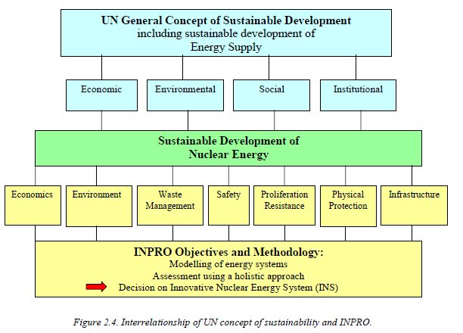
INTERNATIONAL PROJECT ON INNOVATIVE NUCLEAR REACTORS AND FUEL CYCLES (INPRO)
INPRO CONCEPT OF SUSTAINABLITY
Brundtland definition of sustainability: Development that meets the needs of the present without compromising the ability of future generations to meet their own needs.

Slide 8
Experience with NESA
6 national assessments
Argentina, Brazil, India, Republic of Korea as technology developer.
Armenia, and Ukraine as technology user.
Results documented in IAEA report TECDOC-1636
Notes:
To date a number of INPRO assessments have been completed:
Six national assessments - performed by Argentina, Brazil, India, and the Republic of Korea, as technology holder countries and by Armenia and Ukraine as technology user countries.
The studies had different objectives and different scopes. They have been documented in IAEA report TECDOC-1636 published in 2009.

Slide 9
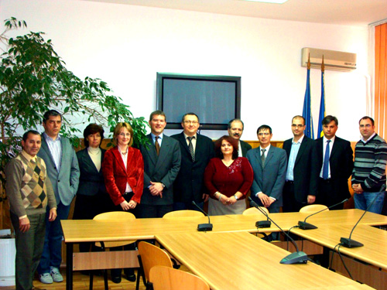
National NESA
Completed
Ukraine – part 1
Belarus
Ongoing
Ukraine – part 2
Indonesia
Romania
Planned
Kazakhstan
Several other countries
Notes:
One multinational assessment was performed to evaluate a nuclear energy system based on fast reactors with a closed fuel cycle. Eight countries participated in this study- Canada, China. France, India, Japan, Republic of Korea, Russian Federation and Ukraine.
The participants in the national and international NESA reported that the insights gained from the studies were worthwhile and justified the effort invested in the studies. The participants also provided valuable recommendations to the INPRO group, one of which was to support assessors with training and with a NESA support package, both of which are currently under development.

Slide 10
Project 2: GLOBAL NUCLEAR ENERGY SCENARIOS
Project 2 helps participating countries define comprehensive national energy strategies by providing a framework for the analysis and assessment of :
how to make a transition from the current fleet of reactors and nuclear fuel cycles to a future nuclear energy system
how national energy system could contribute to, and benefit from regional and global nuclear energy system
the role which cooperation with other countries may play in a transition to a future nuclear energy system

Slide 11
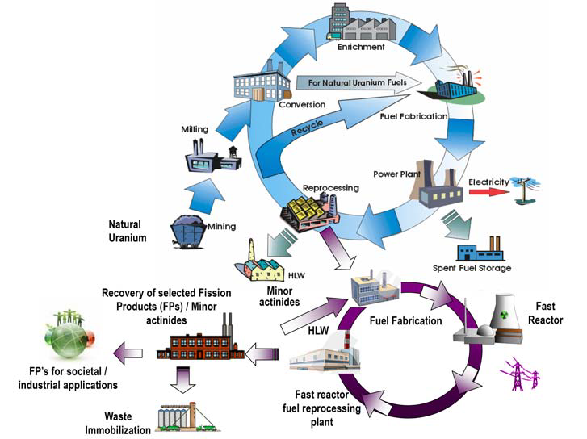
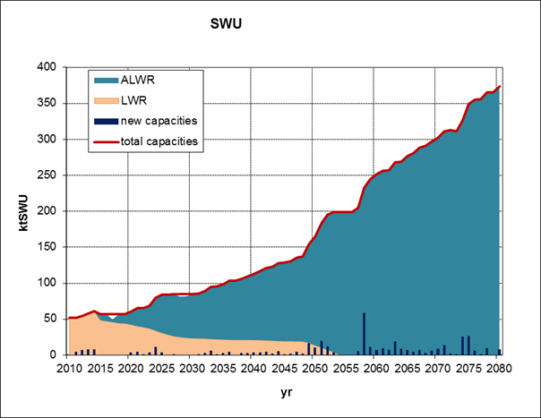
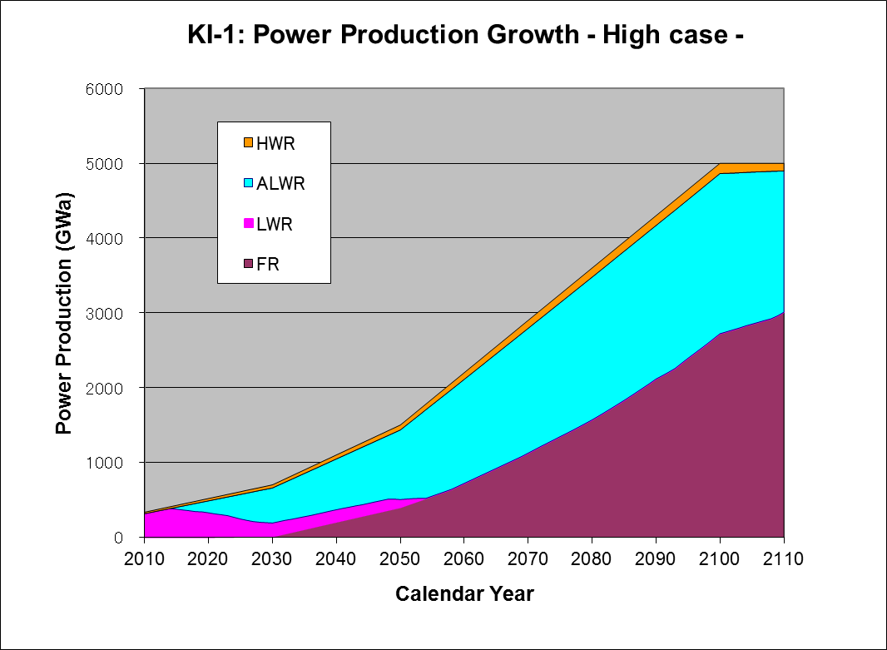
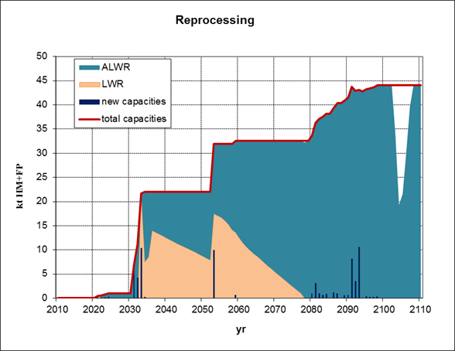
Project 2: GLOBAL NUCLEAR ENERGY SCENARIOS

Slide 12
Global Architecture of Innovative Nuclear Energy Systems (GAINS) Objectives
Rationale
Increasing interest in MSs in joint modelling of global and regional trends in nuclear power taking into account technical innovations and multilateral cooperation
Modelling of the kind requires agreed methodological platform to analyse transition strategies from the present to future nuclear energy system (NES)
Overall objectives:
Address technical & institutional issues of developing a global architecture for the sustainable NES in the 21st century:
develop a framework (common methodological platform, databases, assumptions & boundary conditions);
perform sample studies;
indicate potential areas for application of GAINS framework

Slide 13
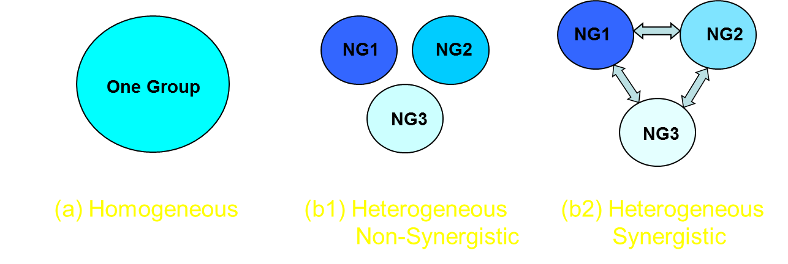
GAINS Framework (1)
WORLD MODELS
Most analyses treat world as single technology group
Assumes all follow the same strategy and use the same facilities
GAINS Framework also supports breaking world into three separate nuclear strategy groups following different fuel cycle strategies
NG1 starts with LWRs, transitions to a closed fuel cycle with fast reactors
NG2 maintains an open fuel cycle with LWRs and HWRs
NG3 starts with no reactors, develops LWRs & minimal fuel cycle infrastructure
NG1:NG2:NG3 = 0.4 : 0.4 : 0.2 with further sensitivity studies

Slide 14
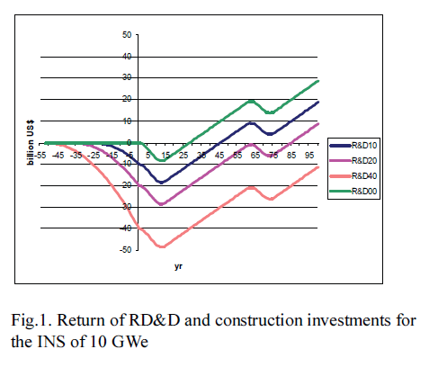
GAINS Main Conclusions (1)
WHICH MODEL WOULD THE WORLD FOLLOW? ADDITIONAL ECONOMIC STUDY
Conclusions:
For small programmes of the fast reactors/closed nuclear fuel cycle deployment the economic benefits from their introduction would be substantially lower than the amount of investments needed for RD&D, licensing and deployment.
Only a few countries in the world with large nuclear energy programmes (30 GW(e) for fast reactors) can bear the burden of the technology development for fast reactors/closed nuclear fuel cycle.
Therefore, global nuclear energy system would follow a heterogeneous world model, at least, within the present century.

Slide 15
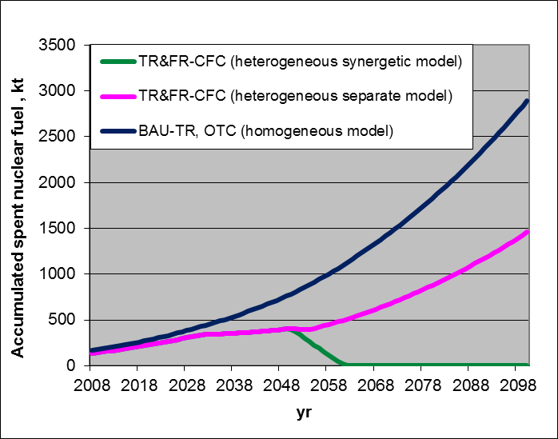
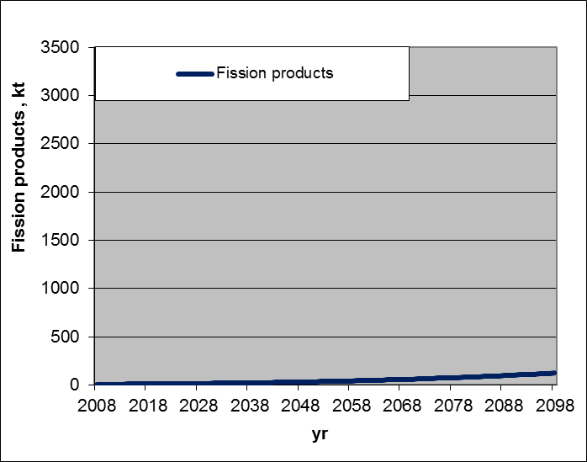
GAINS Main Conclusions (2)
SYNERGISTIC HETEROGENEOUS CASE: MINIMIZED SPENT FUEL ACCUMULATION
Although few (NG1) countries will master fast reactor/fuel cycle technologies, all other countries (NG3 and NG2) could benefit from this if they follow synergistic approach in fuel cycle back-end, by sending their SNF to NG1 for reprocessing and used in fast reactor programmes
Progressive accumulation of SNF on a regional and global scale could be mitigated or even reversed to limit the inventory of such fuel to MA and FP, or even only FP if MA are further incinerated in FR or dedicated transmutation systems
2100: 2500 GW(e) scenario

Slide 16
Project 2: Collaborative Project SYNERGIES
Synergistic Nuclear Energy Regional Group Interactions Evaluated for Sustainability (2011 – 2014)
Objectives:
To identify and evaluate mutually beneficial collaborative architectures and the driving forces and impediments for achieving globally sustainable nuclear energy systems
To identify short-term and medium-term collaborative actions capable to develop pathways to long-term sustainability.
Participants
Algeria, Armenia, Belarus, Belgium, Bulgaria, Canada, China, France, India, Indonesia, Israel, Italy, Japan, Republic of Korea, Malaysia, OECD-NEA, Pakistan, Poland, Romania, Russian Federation, Spain, Ukraine, USA and Vietnam are involved as participants or observers in different tasks.

Slide 17
SYNERGIES Structure
Task 1 (Core Task). Evaluation of Synergistic Collaborative Scenarios of Fuel Cycle Infrastructure Development
Task 4 (Cross-cutting Task). Elaboration of key indicators specific for synergistic collaboration, including economic assessment methods
Task 2 (Support Task). Evaluation of Additional Options for NES with Thermal and Fast Reactors
Task 3 (Support Task). Evaluation of Options for Minor Actinide Management (NES Expansion & Legacy Waste)

Slide 18
Task 1: Case studies defined around selected items of the SYNERGIES Storyline

Slide 19
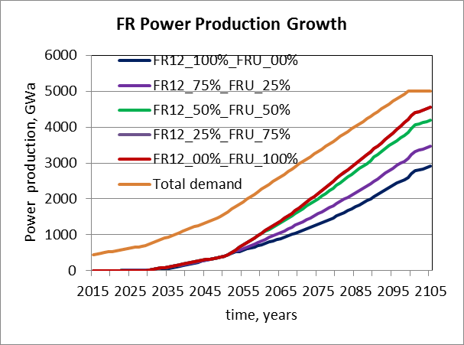
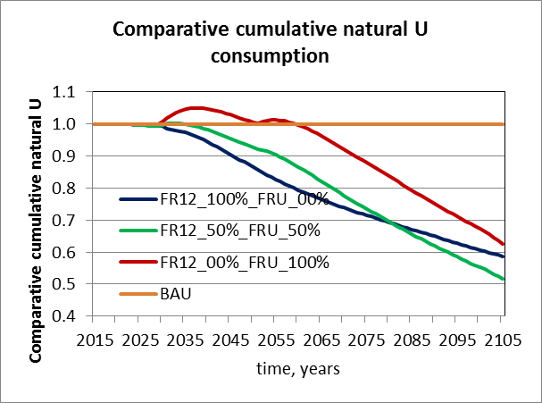
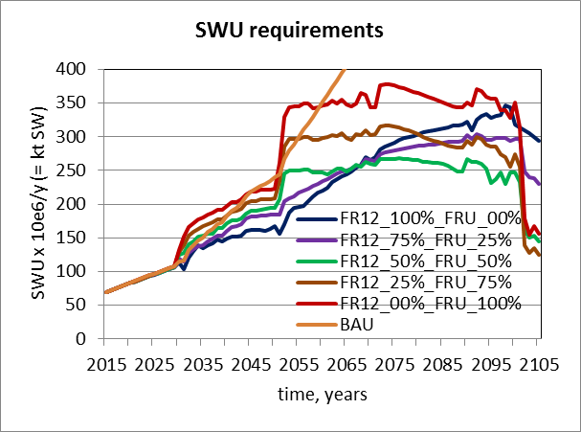
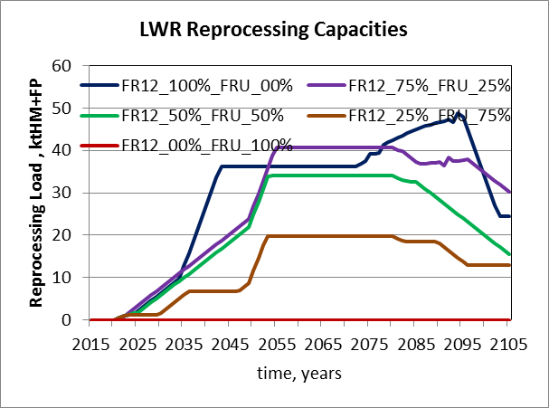
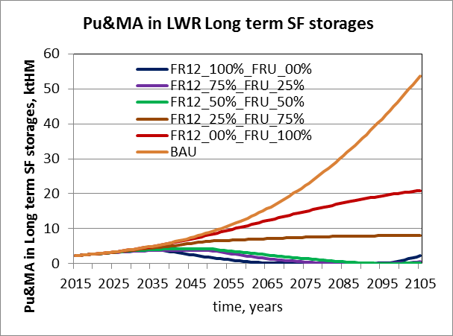
Task 2. Example of results: Scenarios with alternative fast reactor deployment approach
Combined deployment strategy wherein part of FR are started
with U-Pu load and part – with enriched U load has a potential to offer attractive compromises in a closed nuclear fuel cycle

Slide 20
SYNERGIES: Expected Outcomes
SYNERGIES is deemed to support development of comprehensive national nuclear energy strategies regarding international collaboration to achieve sustainable regional and global NES.
In particular, SYNERGIES will help:
define attractive innovative fuel cycle options possible at a regional level and promote an improved understanding of associated front-end and back-end regional interactions
identify technical and institutional gaps that still need to be addressed within the specific future projects
- Next logical step could be to identify “who could do what, where and when” to achieve sustainable NES

Slide 21
Collaborative project ROADMAPS
Overall objective:
Develop a structured approach for achieving globally sustainable nuclear energy while providing models of cooperation among countries and a template for documenting actions, scope of work, and timeframes by particular stakeholders for specific collaborative efforts.
Specific objectives:
Identify stages of sustainability;
Identify required technologies;
Identify enabling institutional measures;
Identify economic approaches;
Identify transition pathways;
Populate an international cooperative roadmap to the extent that it includes historic progress, current status, and remaining gaps;
Provide guidance and reference material for developing cooperative regional or country-specific roadmaps
Include (as Annexes to the report – contributions from Member States) any collaborative or country level roadmaps that may be volunteered by participants during the term of the project.

Slide 22
Collaborative project ROADMAPS
To achieve its objective, ROADMAPS will integrate the outputs of GAINS, SYNERGIES and several other INPRO collaborative projects, as well as the outputs of and the IAEA Technical Working Groups on nuclear reactors and fuel cycles. The collaborative project will, therefore, serve as an umbrella to facilitate effective use of the outputs of the INPRO projects by Member States on the way to enhance cooperation.
Expected outcomes:
The ROADMAPS document will provide context for organizations to develop solutions to identified gaps in the technology and institutional areas;
The ROADMAPS document will provide context and a guiding template for lower level, more specific roadmaps to follow and link to. As these regional or country-level roadmaps are developed and linked, the composite will grow into an integrated plan for achieving global sustainability of nuclear energy systems.

Slide 23
INPRO project 4: Dialogue Forum 4, 30 July – 3 August 2012, VIC, Vienna
Dialogue Forum on Drivers and Impediments for Regional Cooperation on the Way to Sustainable Nuclear Energy Systems
Objectives:
to bring together technology holders and technology users to exchange views on the benefits and issues associated with regional cooperation in building sustainable nuclear energy systems (NES)
specifically, to understand the standpoints of the user and the supplier countries regarding the driving forces and the impediments for such a cooperation
Participation: 39 participants and presenters from 30 IAEA Member States
Findings: international solutions for issues in Front-end and Back-end of NFC is preferable

Slide 24
Rated importance of collaboration among countries (questionnaire summary)

Slide 25
Questionnaire: Preferences in final disposal of waste

Slide 26
INPRO Dialogue Forum 4, 30 July – 3 August 2012, VIC, Vienna
Summary of identified drivers:
Option to enhance energy security through assuring energy independence on regional level
Economic and macro-economic benefits: possible benefits measured in cost savings and mitigated investment risks
Option of shared resource management (collaboration in R&D, shared R&D infrastructure, expertise sharing on licensing, regulations, EIA, radiological protection, waste management, etc.)
Security of supply considerations (assurance of supply, effective spent nuclear fuel management)
Considerations of ultimate waste management (shared repository costs, etc.)
Option of best practice sharing, including safety
Considerations of risk management, including several models for shared NPP development with vendor

Slide 27
Conclusions
INPRO provides the basis for enhanced international cooperation in area of Nuclear Fuel Cycle.
INPRO fosters collaboration needed to develop future NES.
The analytical framework established in INPRO makes it possible to start projects aimed at developing specific mechanisms for cooperation.
Results of INPRO are evidence-based recommendations for the development of national nuclear power programmes in tight integration with leading nuclear countries.

Slide 28
THANK YOU! Please, go for more detail to: http://www.iaea.org/INPRO/ Vladimir KUZNETSOV V.Kuznetsov@iaea.org

