Slide 1
Nuclear Education in Iran Based on Technological Needs
by G. Raisali
Nuclear Science & Technology Research Institute,
Atomic Energy Organization of Iran (AEOI)

Slide 2
AEOI supports nuclear education by:
Contributing in the development of universities educational programs
Technical support
Financial support

Slide 3
Iran is developing education associated with the development of its nuclear technology needs regarding
Rising demand for electrical energy and other applications of nuclear technology specially in:
Health and safety
Agriculture, medicine and industry

Slide 4
Technological needs
The main technological needs are in industrial sections such as oil industry, agriculture and medicine that can be supported by AEOI
Educational programs are necessary to train researchers for supporting research and development in several fields
Educational and training activities are not limited to nuclear science and technology, but also in several other disciplines

Slide 5
Human resource development is an important necessity in the safe operation of nuclear facilities that is fulfilled through training with:
Cooperation with universities and technical institutes for providing educated and skilled workforce
Cooperation with NGOs and other educational institutes

Slide 6
Cooperation with universities
Cooperation With high-ranked universities to establish and promote their departments related to nuclear science and technology and its applications
The cooperation is through contracts and agreements with universities and research institutes to support and persuading them to take part in applied projects regarding country needs

Slide 7
Areas of applied research
Nuclear safety
Nuclear power plants
Radiochemistry
Accelerators
Gamma irradiators
Radiopharmaceuticals
Applications of nuclear technology in agriculture, health and industry

Slide 8
Cooperation with other organizations
Supporting non-high ranked educational and research institutes to improve their abilities for future higher level of cooperation
Holding training courses and workshops in cooperation with scientific and technical societies

Slide 9
Some workshops and courses
Nuclear radiation measurement methods
Computational codes in nuclear reactors
Dynamics of nuclear reactors
Application of finite volume methods in reactor thermo-hydraulics
Neutron Activation Analysis

Slide 10
Technical support
PhD and MSc students are allowed to use the services given in facilities belonging to AEOI through contracts and agreements with universities. AEOI library also gives free service to the students
Some AEOI’s facilities are:
Accelerators:
Cyclotron (cyclone 30)
Electron irradiator: rhodotron (TT-200)
Van De Graaf accelerator (3 MeV)

Slide 11
Continued
Reactors:
Tehran Research reactor (TRR)
Zero power research reactor (ZPR)
Subcritical research reactor
Miniature neutron source reactor (MNSR)
Irradiators:
Research gamma irradiator (GC–220)
Industrial gamma irradiator (IR-136) and SSDL calibrated radiation fields

Slide 12
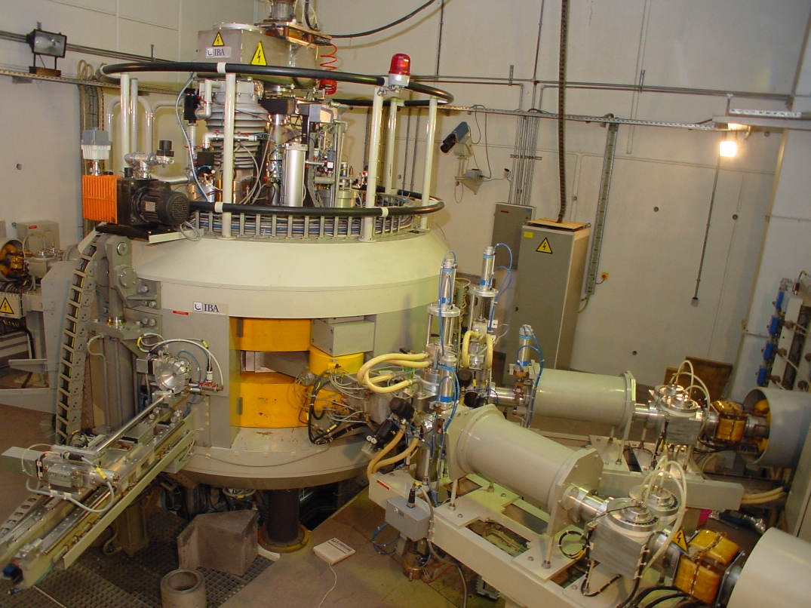
picture
A view of cyclone 30 located in Karaj

Slide 13
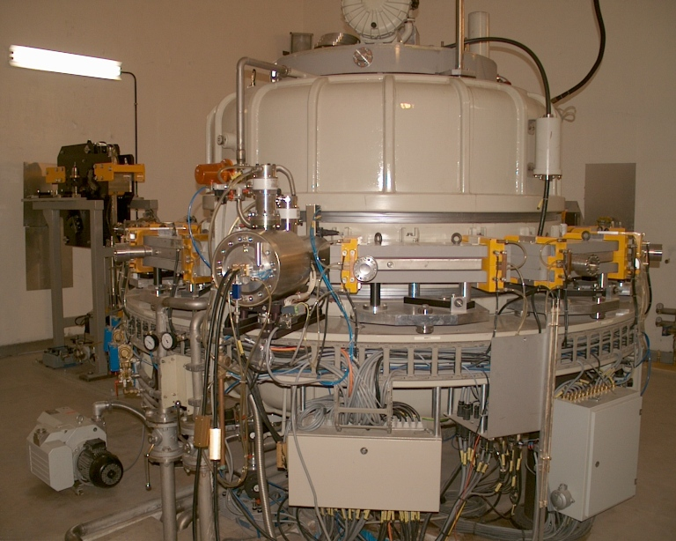
A view of rhodotronTT-200 located in Yazd

Slide 14
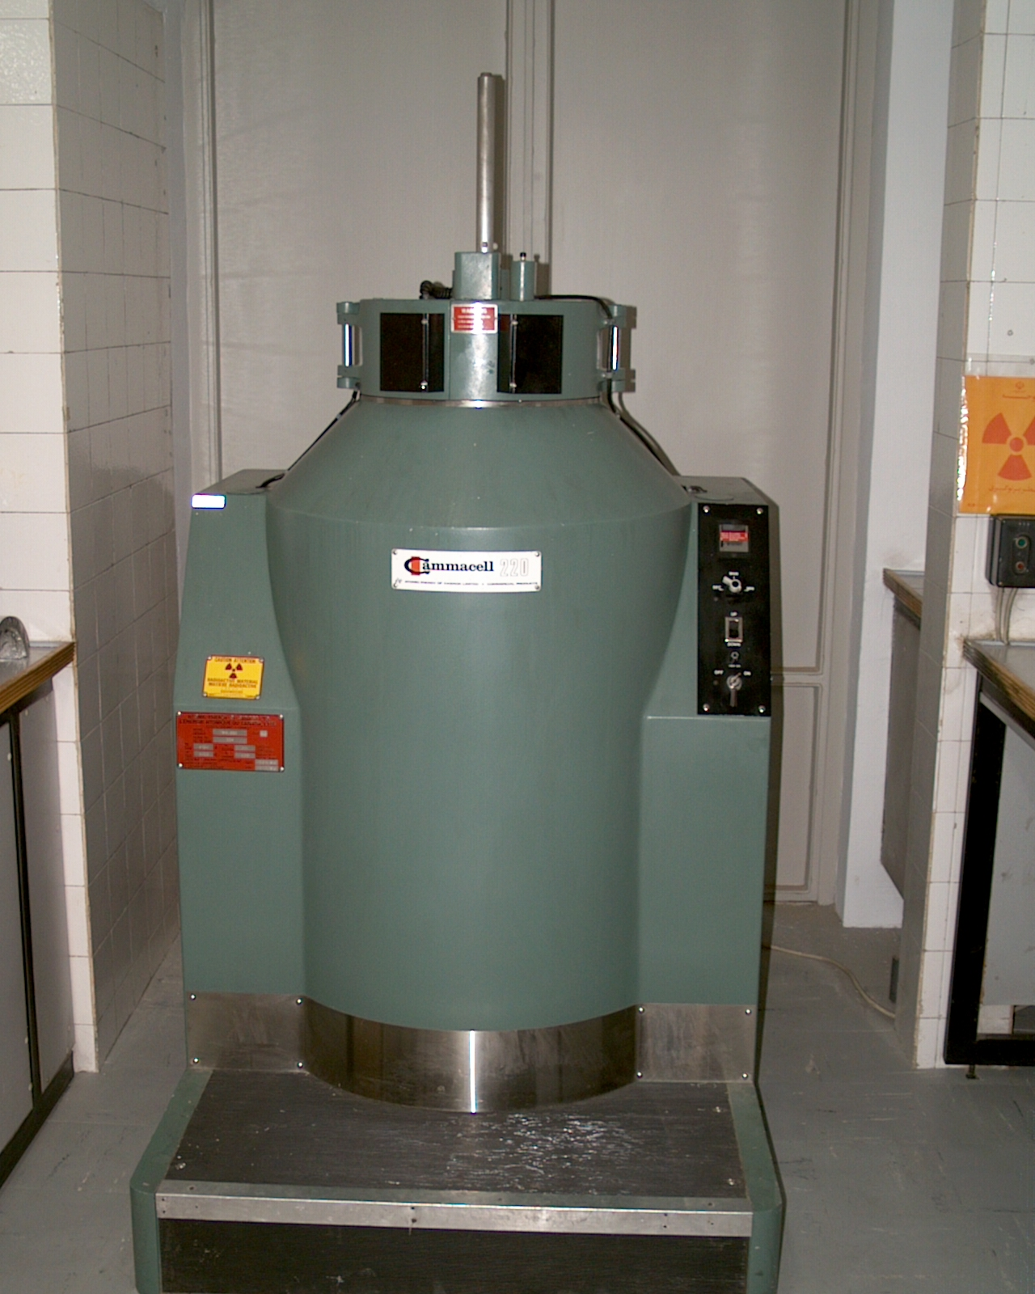
A view of gamma cell GC-220 located in Tehran

Slide 15
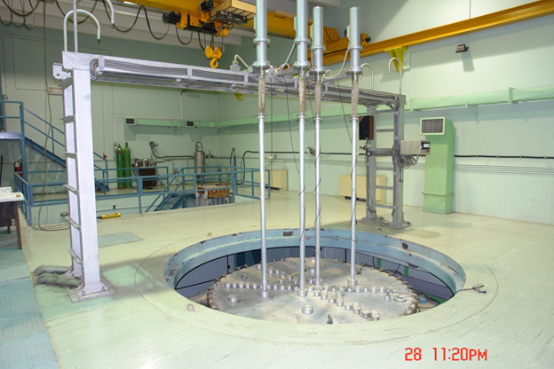
A view of ZPR located in Isfahan

Slide 16
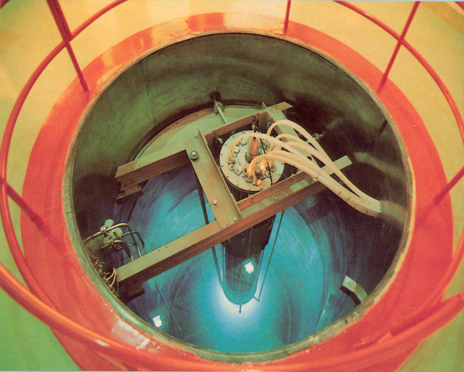
A view of MNSR located in Isfahan

Slide 17
Financial support
Funding for universities to train the PhD students in different fields related to nuclear technology
Scholarships for graduate students in all fields related to nuclear technology and its applications
Post-doc Scholarships for graduated students in all fields related to nuclear technology

Slide 18
Outcomes
The outcomes are:
Implementation of MSc and PhD projects
Technical documents
Products (agricultural lines of mutants, radiopharmaceuticals, …)
Articles published in high-ranked international and Iranian journals;

Slide 19
Some MSc and PhD Project titles
Preparation and quality control of [⁶¹Cu]-bis-8-hydroxy quinolone for PET imaging
Design of thermal hydraulic set loop
Experimental study of heat transfer in spent fuel rods of Bushehr power plant in a pool
Monte Carlo Method and Experimental Validation for Determination of dose distribution of brachytherapy seed I-125 in eye plaque
Study of salinity resistance of wheat mutant lines resulting from irradiation of Tabassi genotype

Slide 20
Continued
Synthesis and Quality control of a diagnostic ¹⁸F radiolabeled peptide for tumor detection.
Evaluation of biological factors and biodistribution of ⁶¹Cu Bleomycine
Evaluation and production of Galium-68 via ⁶⁸Zn(p, n)⁶⁸Ga reaction for use of PET imaging system
Investigation, research and feasibility of ⁹⁰Y production in Tehran research reactor
Investigation and feasibility of ¹⁶⁶Ho production in Tehran research reactor
Production Optimization of ¹⁵³Sm and ¹⁷⁷Lu radioisotopes in the core of TRR

Slide 21
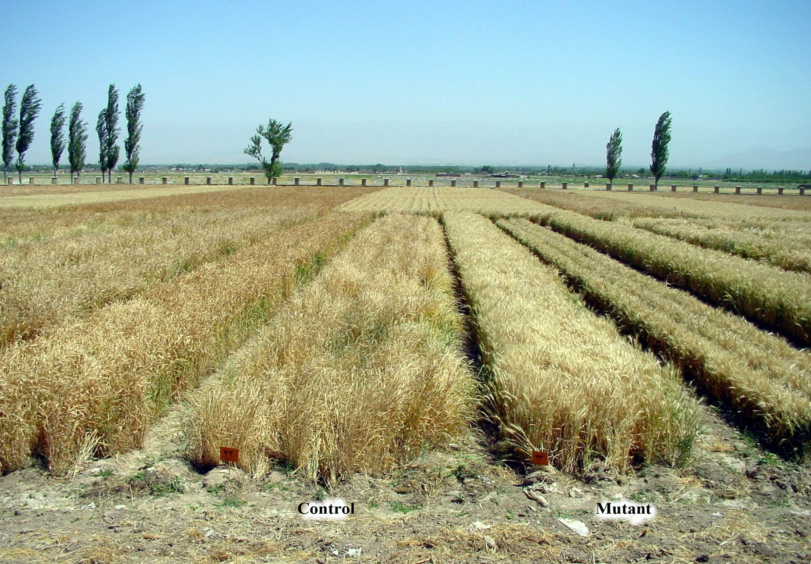
Produced mutant line

Slide 22
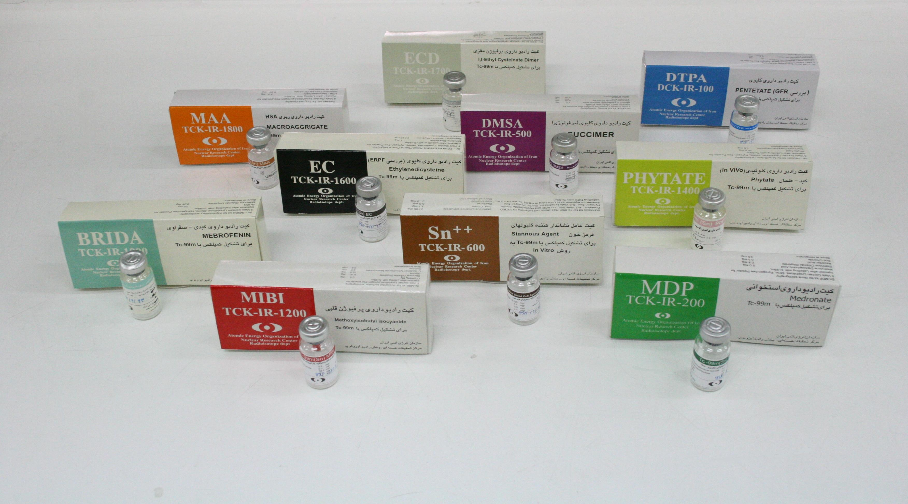
Some of manufactured radiopharmaceuticals by AEOI

Slide 23
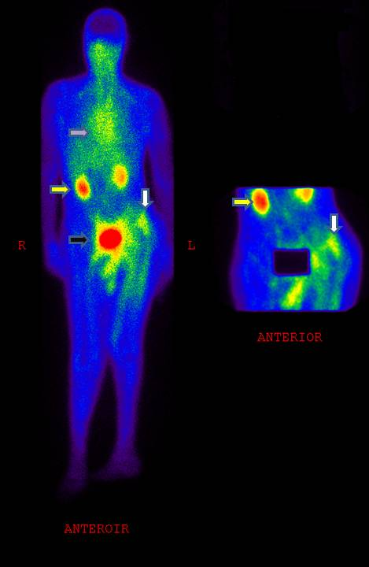
Production and quality control of 99mTc-bombesin

Slide 24
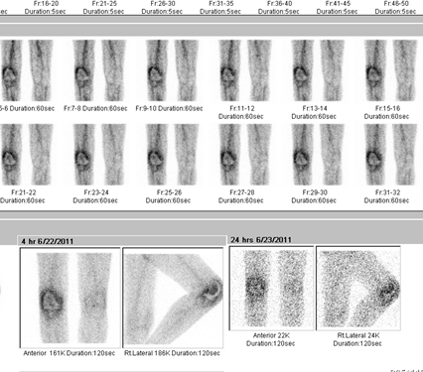
Production and quality control of Lu-177 radiopharmaceuticals
A patient (weight: 74 kg) with knee infection, showing increased uptake due to infection

Slide 25
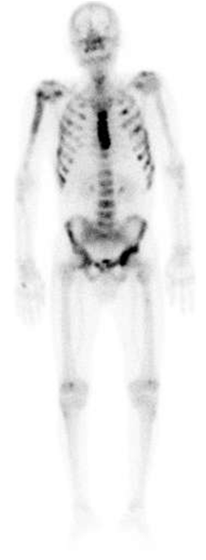
Production and quality control of Sm-153 radiopharmaceticals
Sm-153 EDTMP in an Iranian Patient for Bone Pain palliation in Cancers

Slide 26
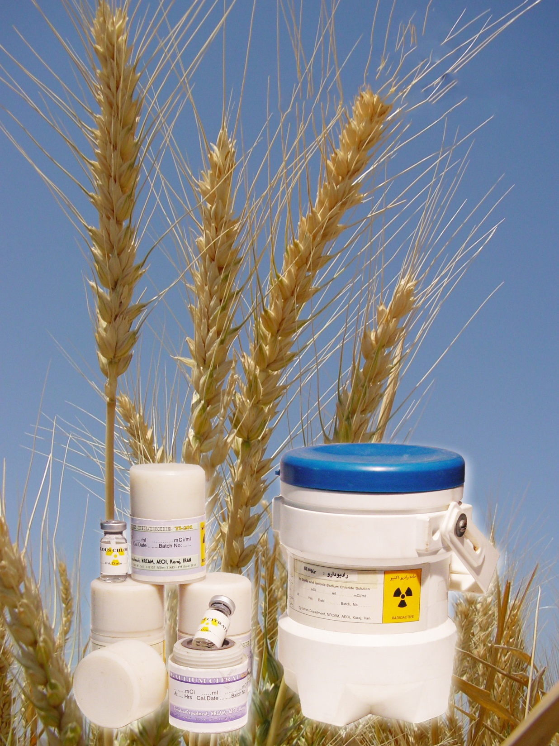
Thanks for Your Attention

